Slide 1

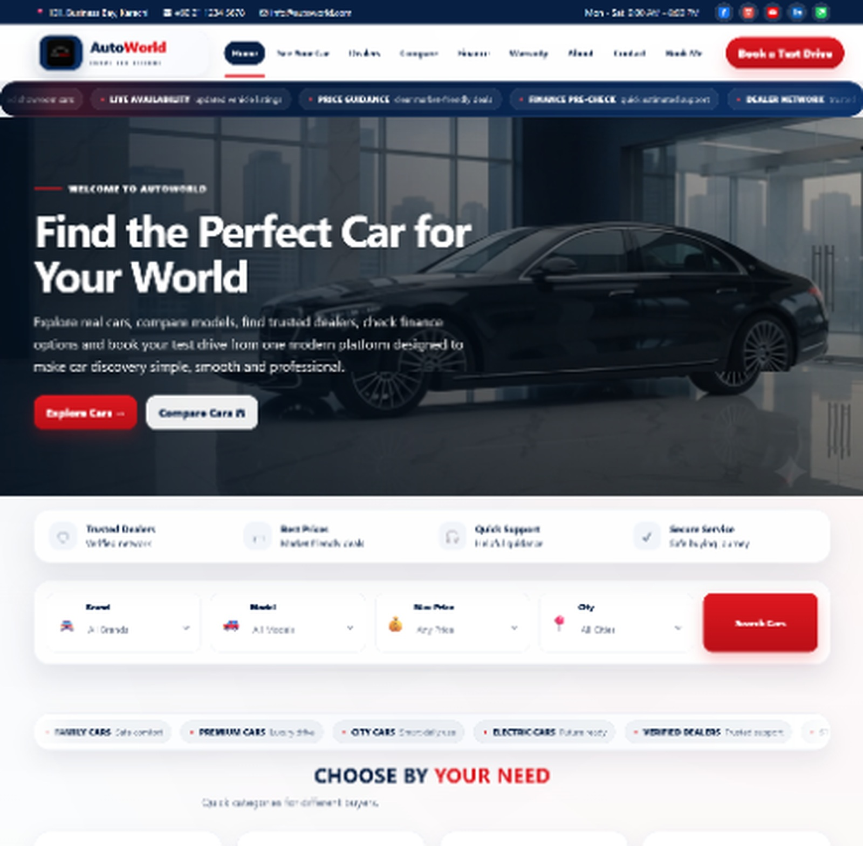
AutoWorld
Car Dealership Information Platform
Search cars, compare models, locate dealers and review support options from one clean interface.
Presented by
Saqib Narejo Student1716313
Sanjana Kumari Student1711864
Nasreen Siddique Student1716338
PROJECT PRESENTATION

Slide 2
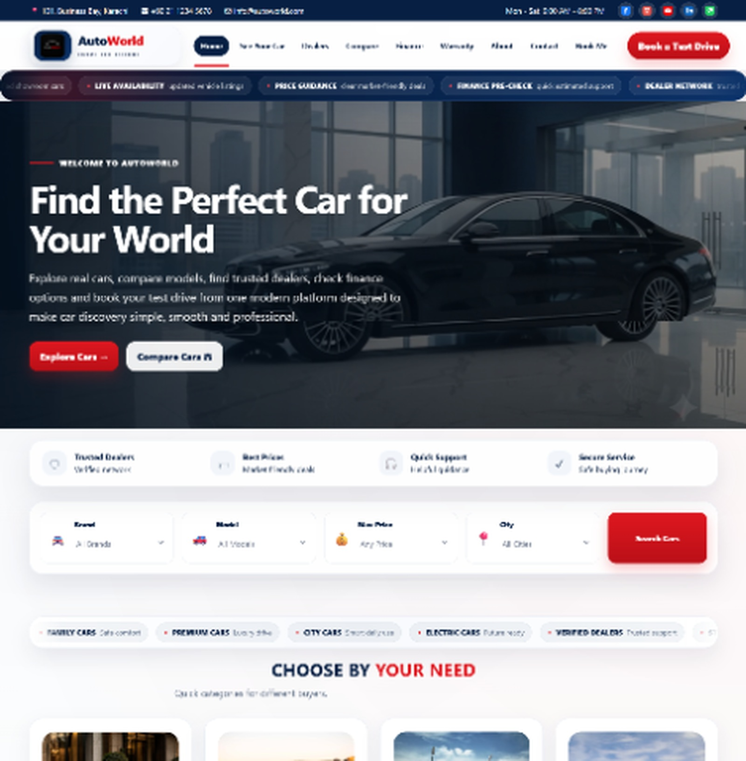
PRESENTATION PLAN
What we will cover today
A short and clear walkthrough of the project, not a documentation readout.
01
Problem
Why this website is needed
02
Solution
What AutoWorld offers
03
Website Tour
Main pages and user journey
04
Technical Build
How the front end works
05
Future Scope
What can be improved next
AutoWorld Project Presentation
02

Slide 3
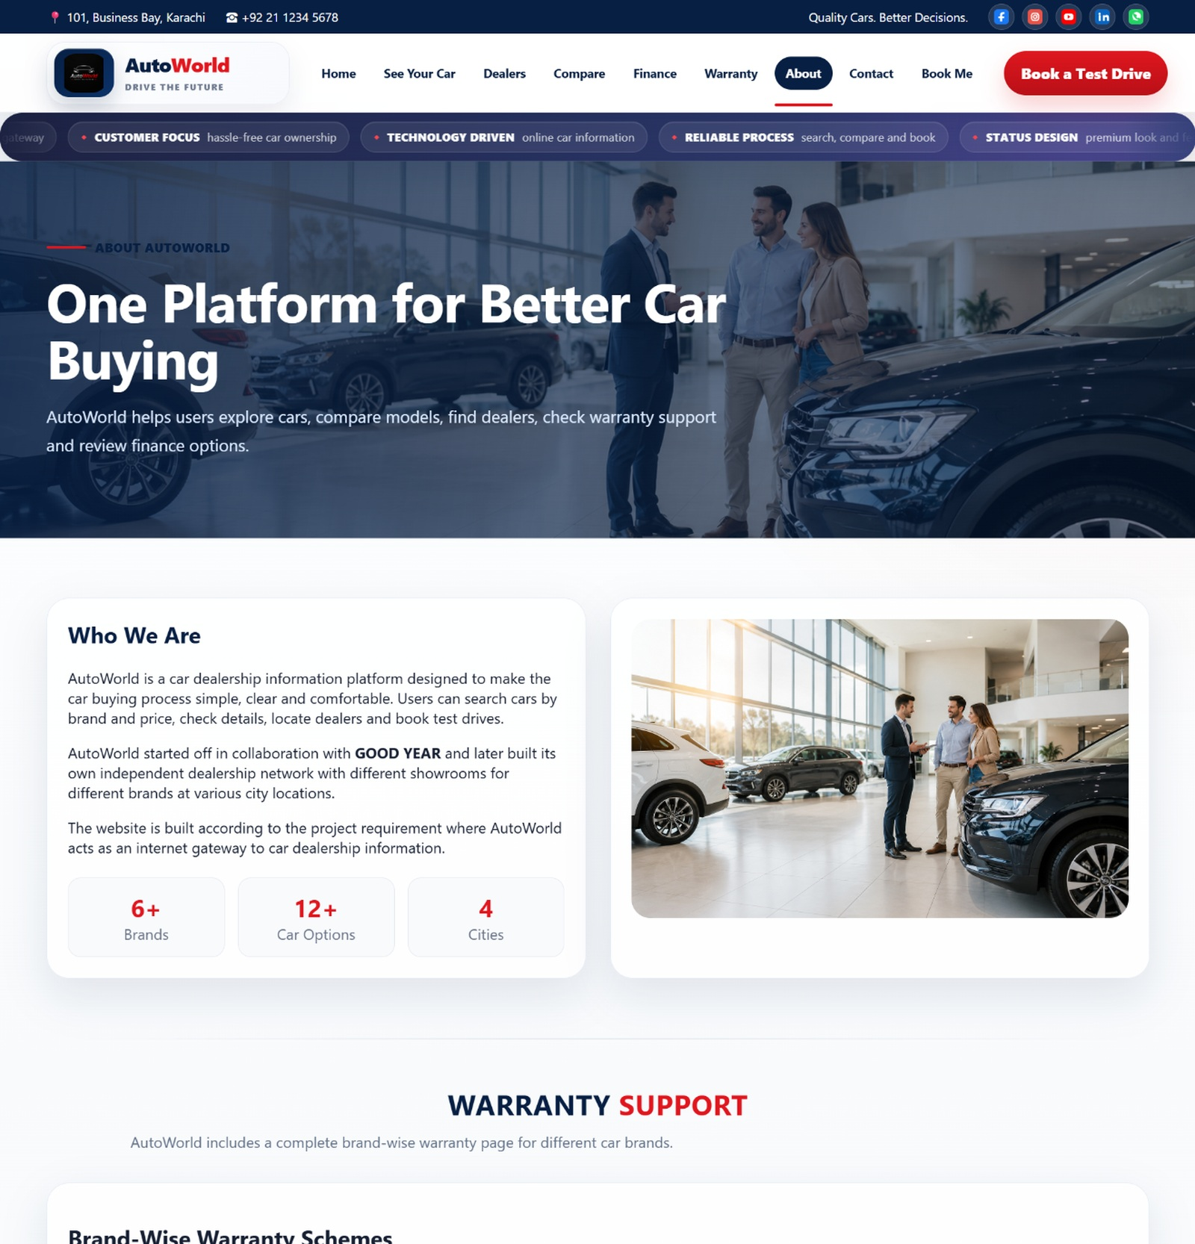
THE PROBLEM
Car buyers need clearer information
Most buyers compare many details before deciding. AutoWorld brings those details together.
Scattered details
Hard comparisons
Prices, features, finance and warranty information are often checked separately.
Users need side-by-side model differences to make quick choices.
Dealer uncertainty
Support questions
A buyer wants city-based dealer details before visiting a showroom.
Warranty, finance and booking queries need one contact point.
AutoWorld Project Presentation
03

Slide 4
OUR SOLUTION
AutoWorld as a guided buying platform
The website gives users a simple path from exploration to inquiry.
One platform. Five clear actions.
Explore official car models
Compare up to three cars
Find verified dealers by city
Review finance and warranty support
Send inquiry or book a visit
AutoWorld Project Presentation
04

Slide 5
USER JOURNEY
From interest to inquiry
The project flow follows how a real buyer checks a car before contacting a dealer.
1
2
3
4
5
Browse
Filter
Compare
Support
Contact
Home + catalog
Brand, budget, city
Model vs model
Finance + warranty
Query or booking
Goal: help users reach a buying decision faster and with less confusion.
AutoWorld Project Presentation
05

Slide 6
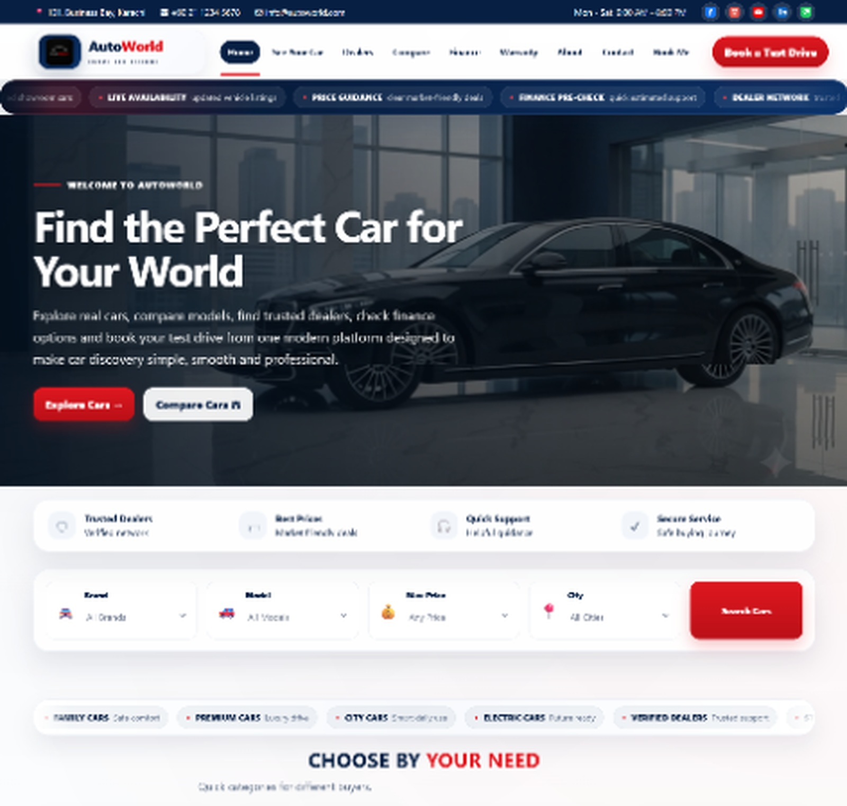
HOME PAGE
First impression and quick entry
The homepage introduces the brand and guides users toward search, comparison and booking.
1
Hero section
Clear headline with primary action buttons.
2
Quick filters
Brand, model, price and city are placed early.
3
Featured cars
Users can start exploring without opening another page.
AutoWorld Project Presentation
06

Slide 7
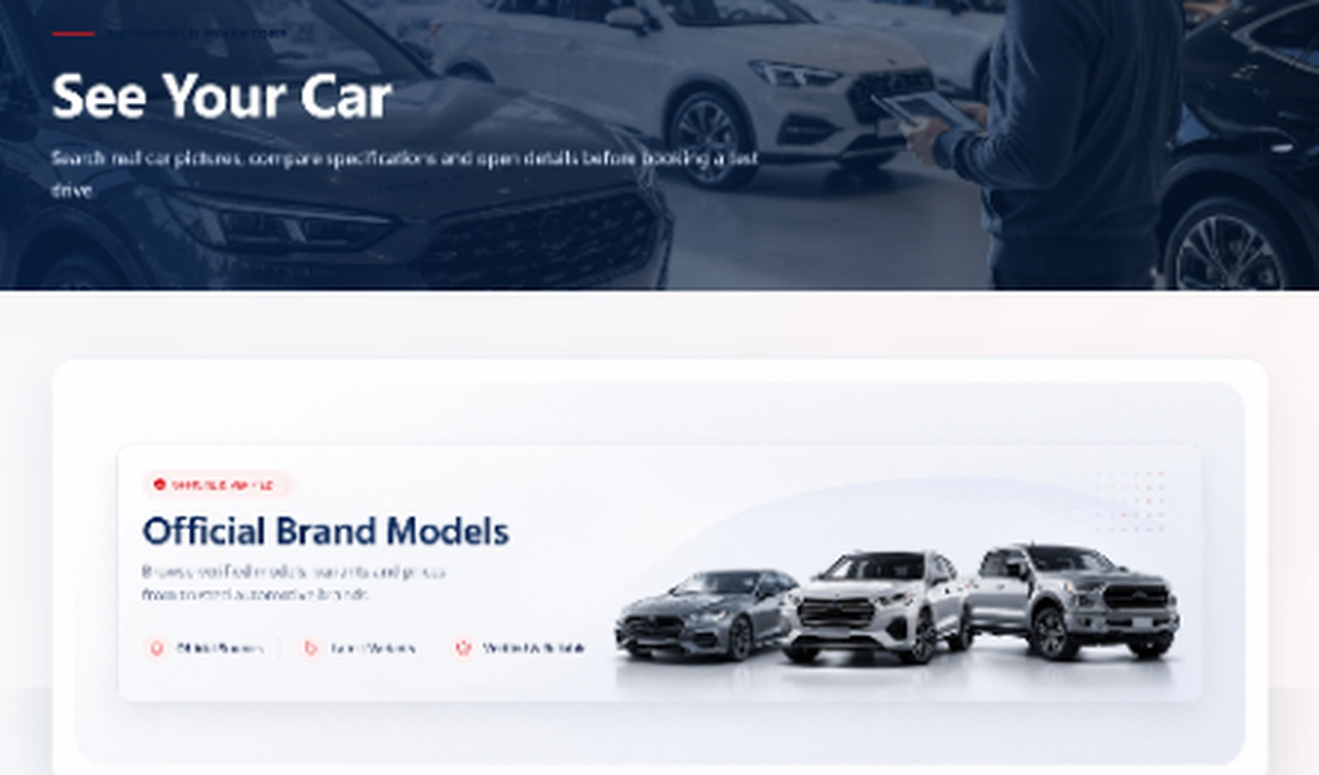
SEE YOUR CAR
Car catalog with clean filters
This page lets users browse official brand models and shortlist cars quickly.
Filter search
Car cards
Brand, model, price range and city filters.
Image, price, engine, mileage and city in one card.
Large visuals
Details action
Car images make browsing easier.
Every card has a direct View Details button.
AutoWorld Project Presentation
07

Slide 8
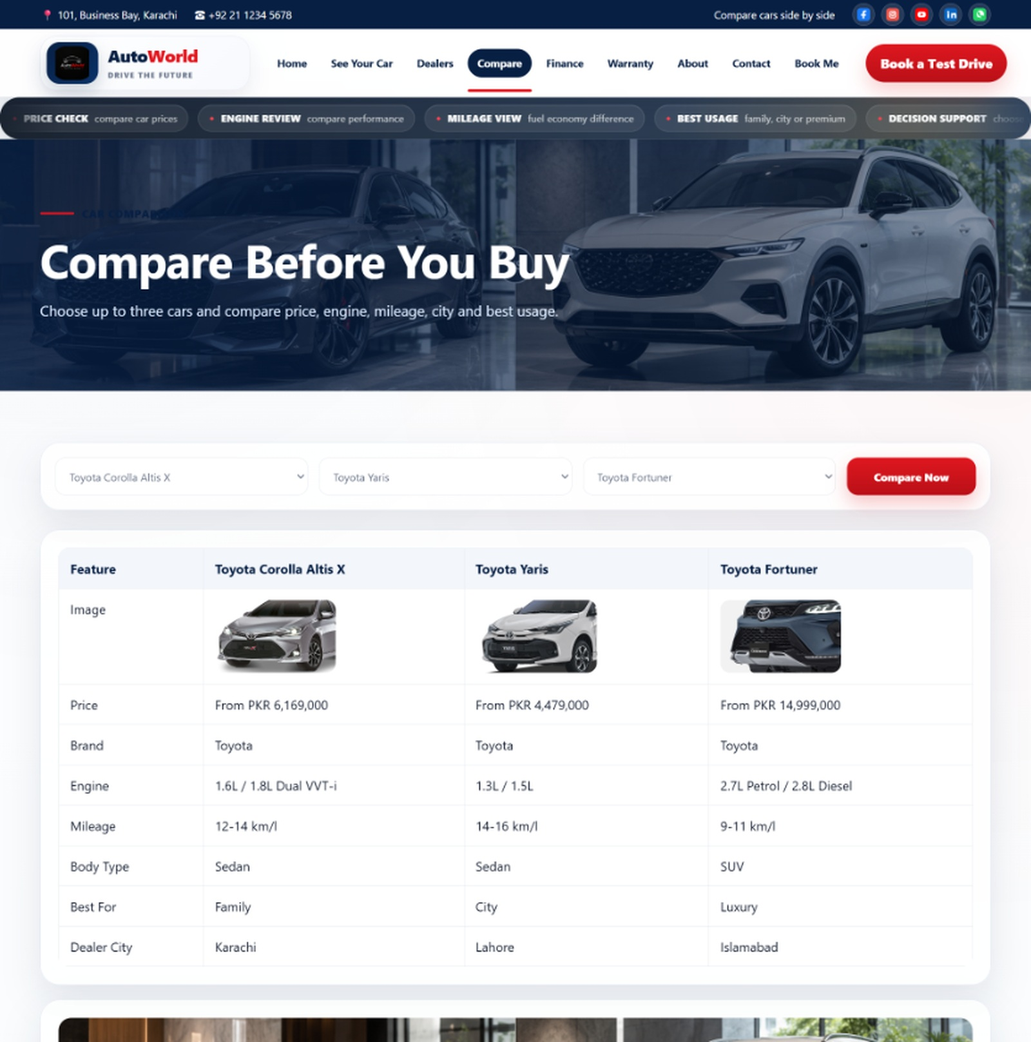
COMPARE CARS
Side-by-side decision support
The comparison page reduces the effort of checking separate model details.
Compare up to three selected cars
View price, engine, mileage, body type and dealer city
Recommended car cards suggest next options
Main benefit: faster and more confident buying decisions
AutoWorld Project Presentation
08

Slide 9
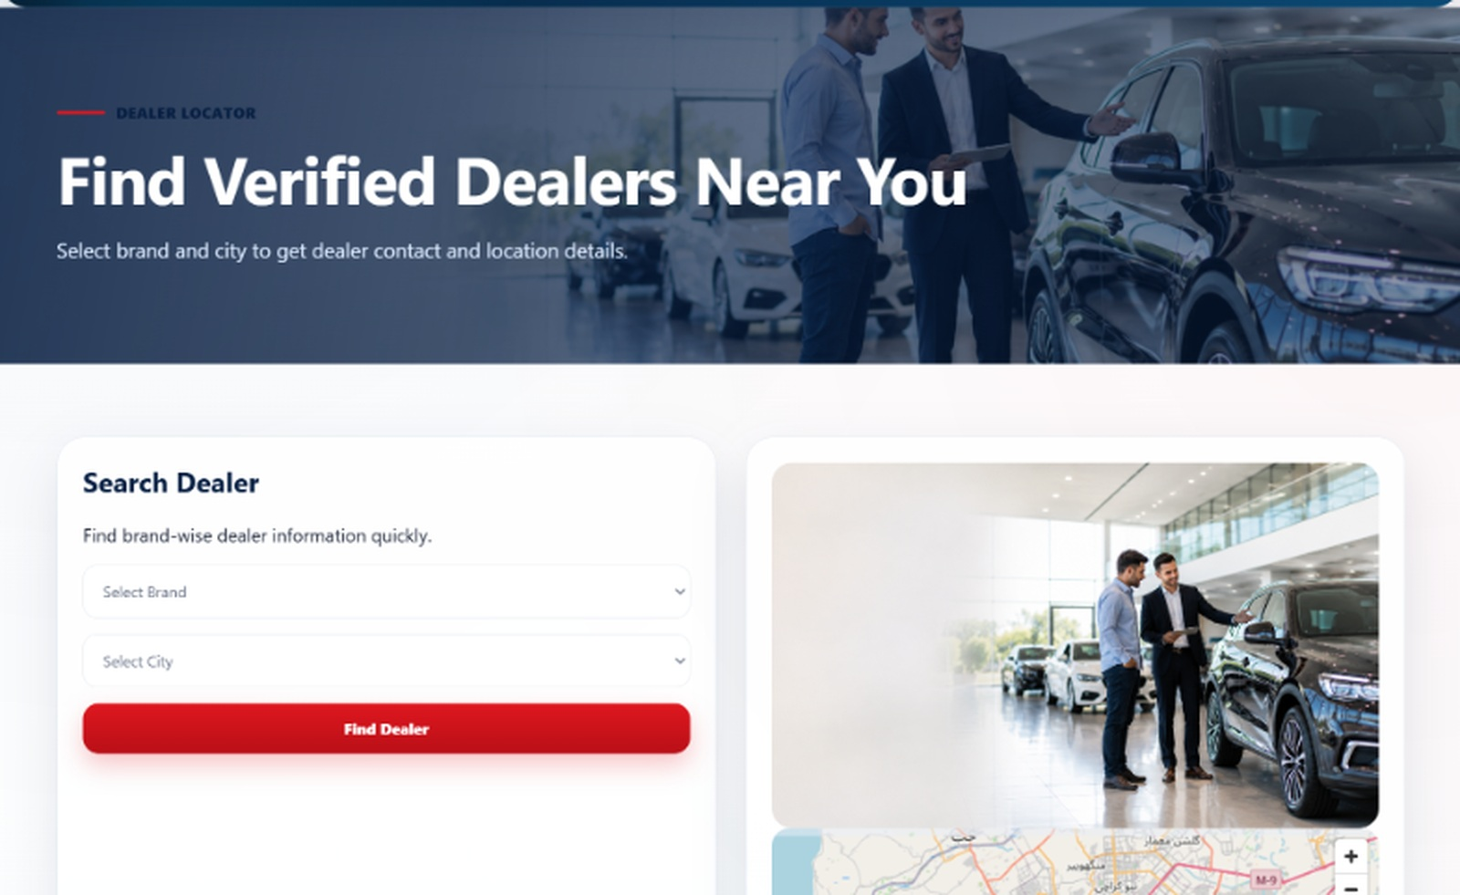
DEALER LOCATOR
Find verified dealers near you
The dealer page connects buyers with showroom details by brand and city.
Search form
Map preview
Select brand and city to get relevant dealer results.
Location section supports physical showroom visits.
Dealer cards
Brand coverage
Each card shows city, address, contact and booking action.
Toyota, Honda, Suzuki, Hyundai, Kia, BMW and Ford.
AutoWorld Project Presentation
09

Slide 10
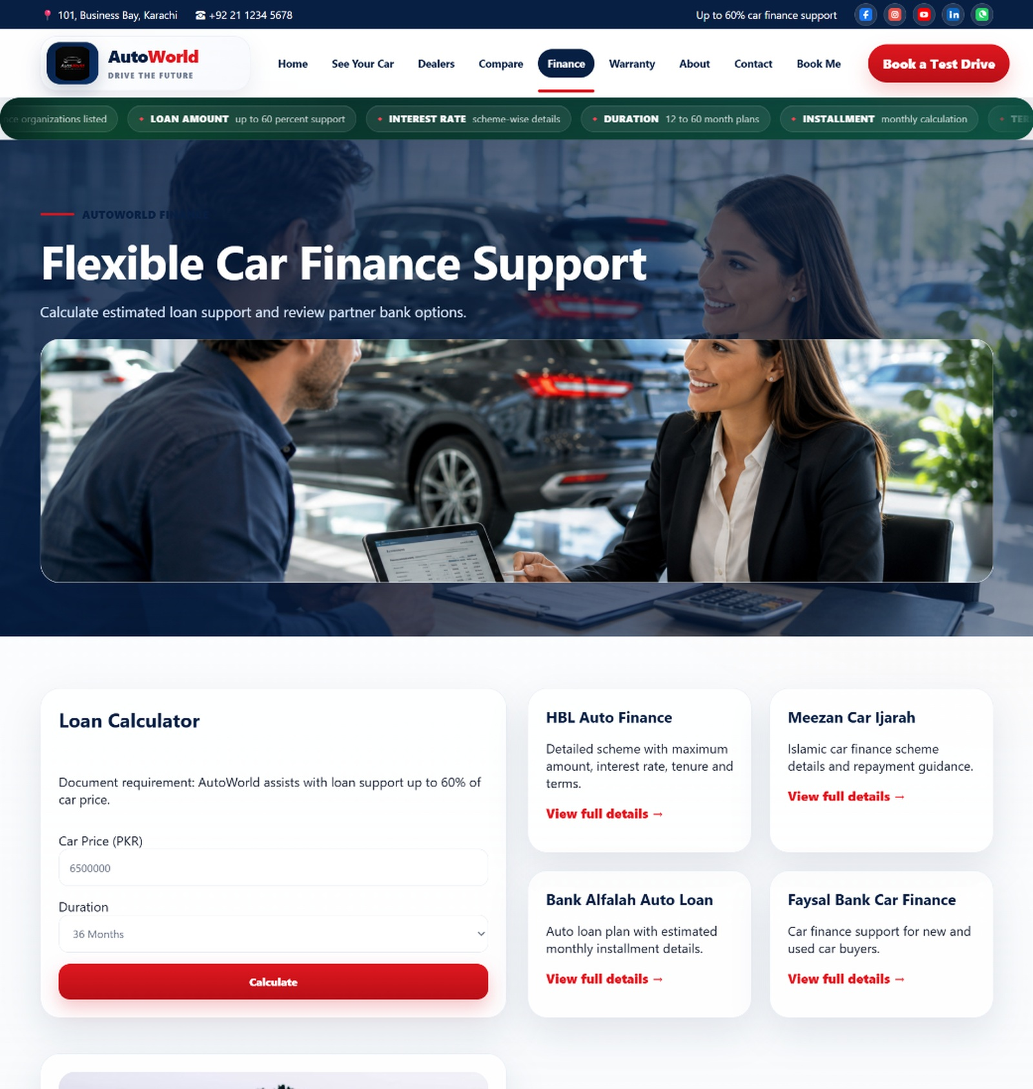
FINANCE SUPPORT
Estimate loan guidance in a simple way
The finance page helps users understand basic payment support before contacting the team.
1
Enter price
The user enters car price in PKR.
2
Choose duration
The page supports duration-based guidance.
3
Review banks
Bank scheme cards show available options.
AutoWorld Project Presentation
10

Slide 11
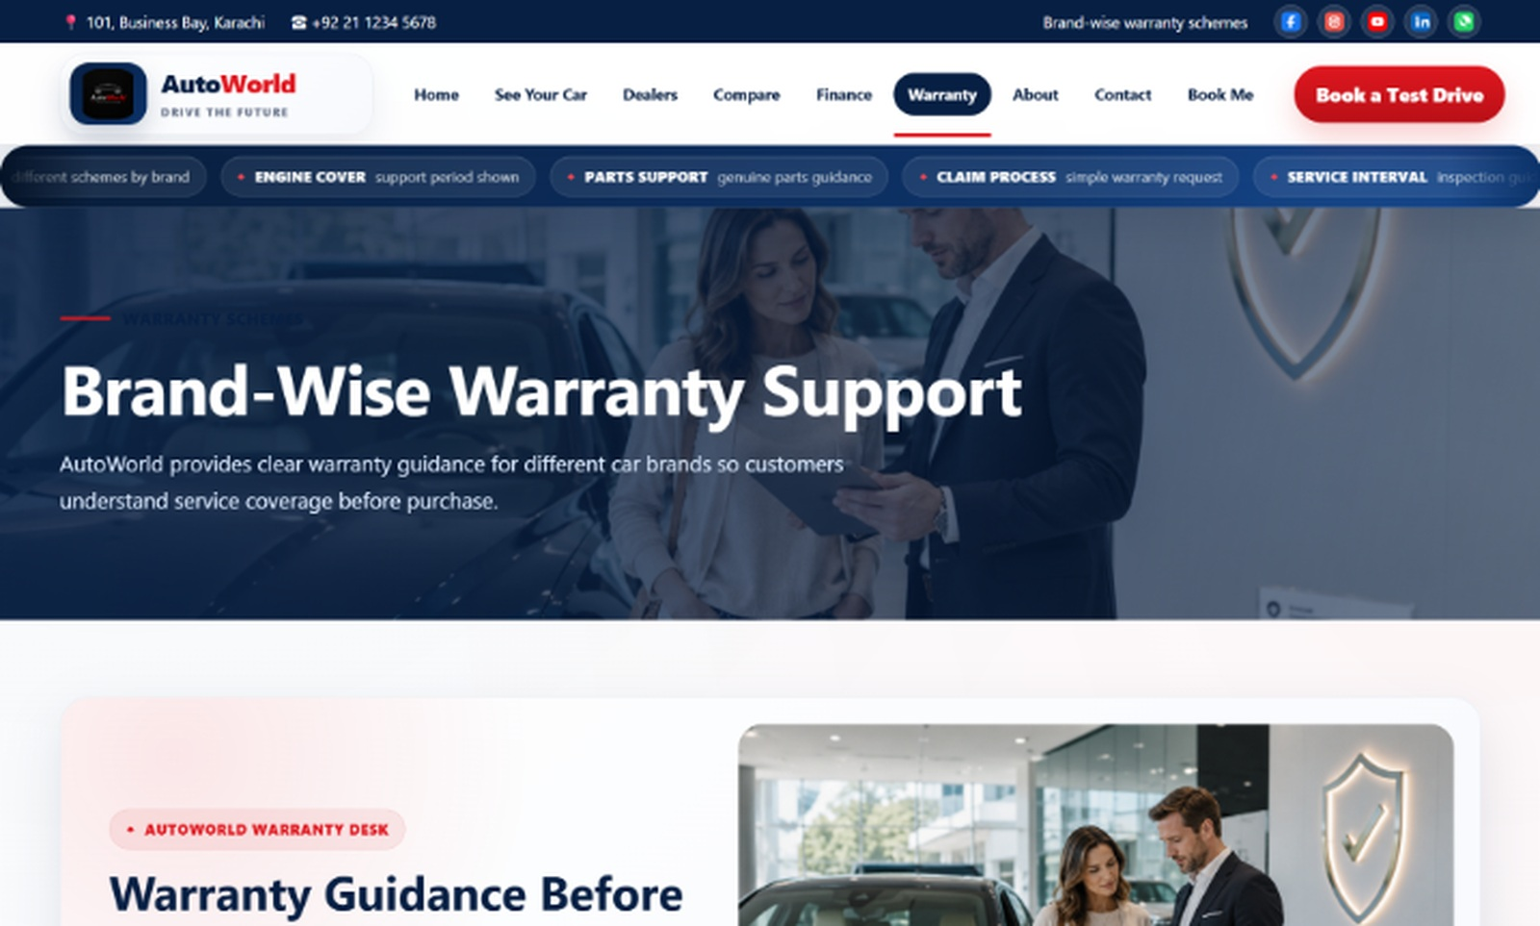
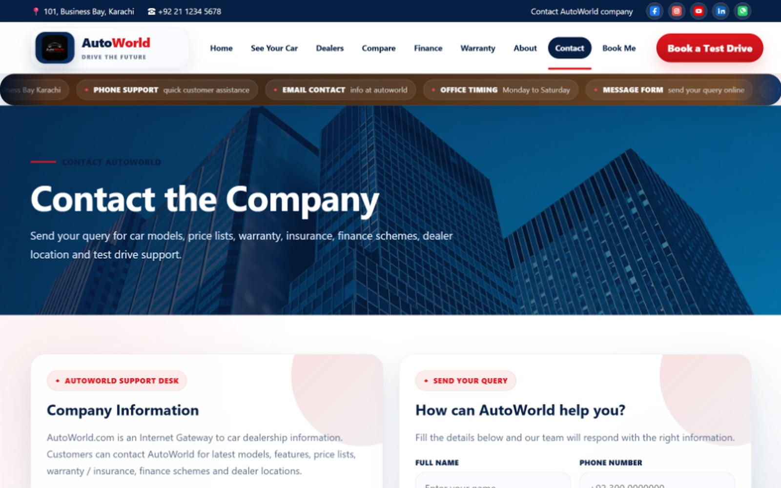
SUPPORT FLOW
Warranty and contact pages
After browsing and comparing, users can ask questions or review support guidance.
WARRANTY GUIDANCE
QUERY SUBMISSION
AutoWorld Project Presentation
11

Slide 12
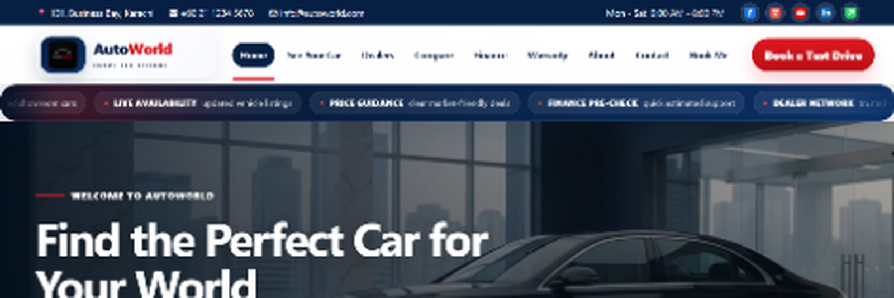
TECHNICAL BUILD
Simple front-end architecture
The project is a static website with reusable styling and JavaScript-powered interactions.
HTML
CSS
JavaScript
Page structure
Design and layout
Filters and actions
Multiple HTML pages connected with consistent navigation
Shared visual system for colors, spacing, buttons and cards
JavaScript supports search, selection, comparison and forms
AutoWorld Project Presentation
12

Slide 13
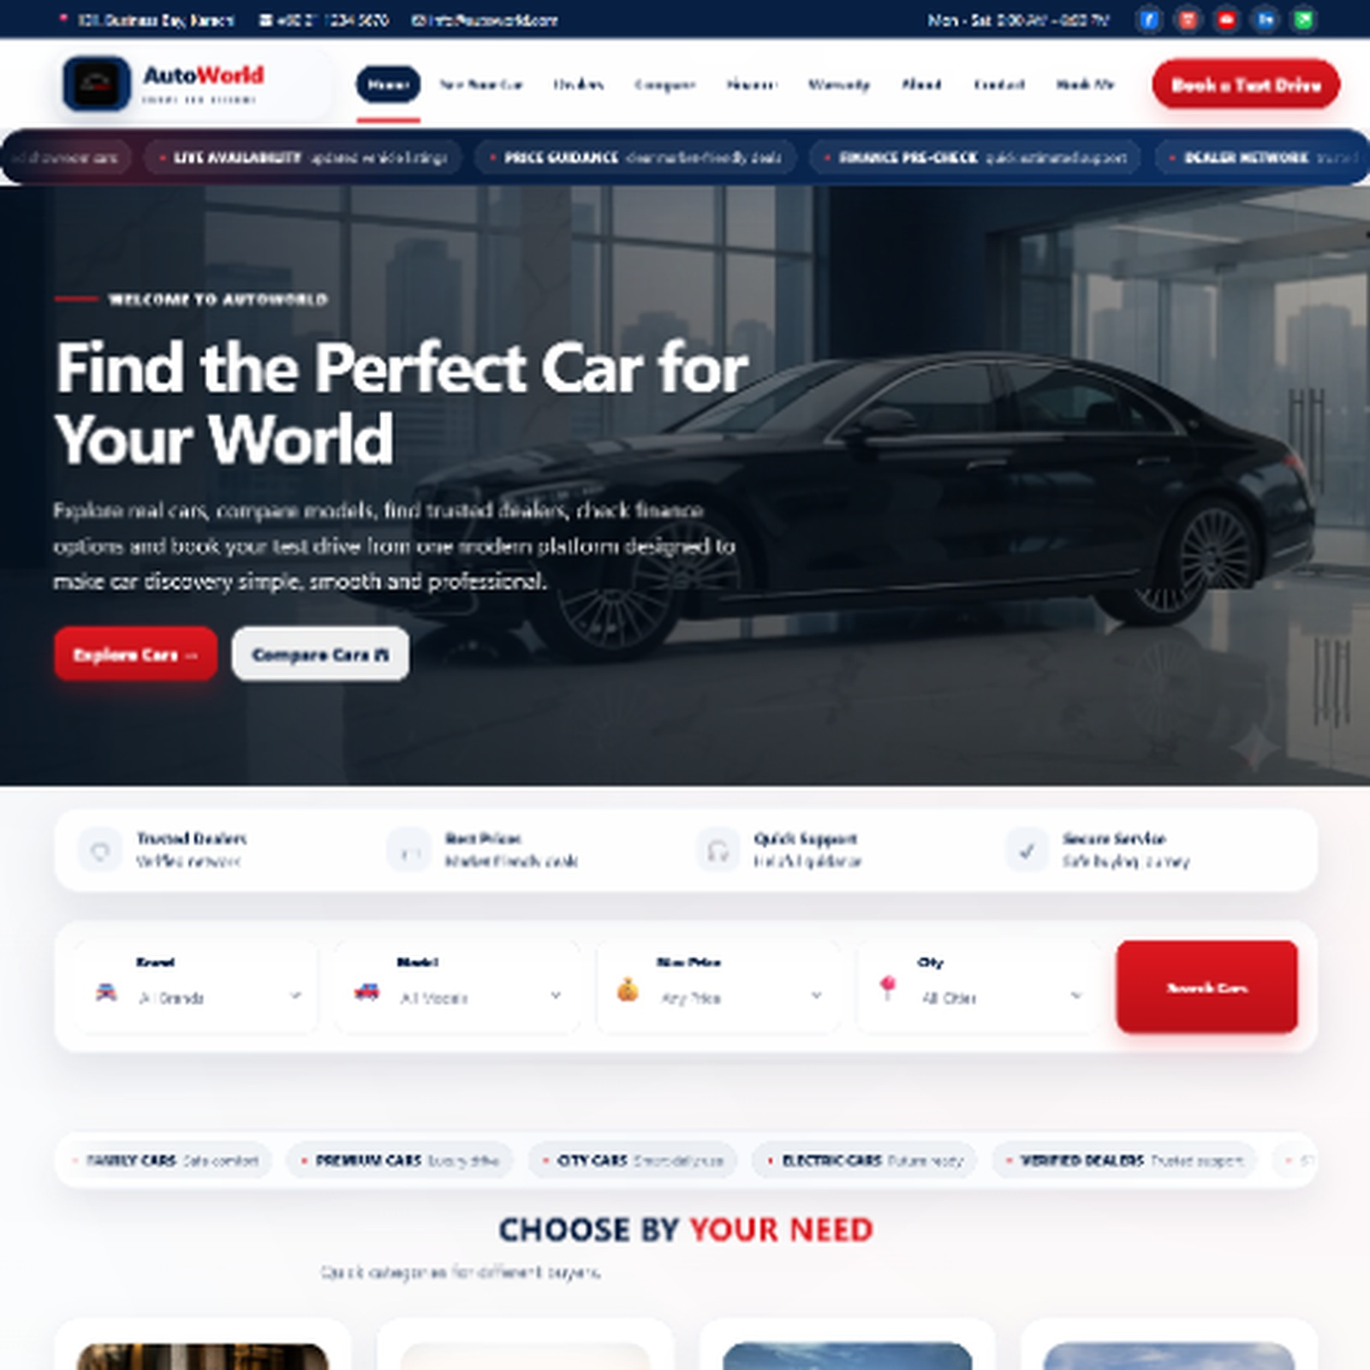
VISUAL DESIGN
Professional automotive look
The interface uses a premium dealership style with strong readability.
Navy
Red
Soft White
Large hero images for automotive feel
Rounded cards for cars, dealers and support blocks
Consistent footer, navigation and call-to-action buttons
AutoWorld Project Presentation
13

Slide 14
FUTURE SCOPE
How AutoWorld can improve further
The current version is a strong front-end prototype. These features can make it production-ready.
Database
Admin panel
User accounts
Dynamic cars, dealers, bookings and inquiries
Staff can manage listings and prices
Save favorites and comparison history
Live APIs
Email alerts
Mobile polish
Bank finance, map and availability integration
Auto confirmation for bookings and queries
More optimized comparison on small screens
AutoWorld Project Presentation
14

Slide 15
Thank You
AutoWorld delivers a clean and practical car dealership information experience for users.
Team Members
Saqib Narejo Student1716313
Sanjana Kumari Student1711864
Nasreen Siddique Student1716338
QUESTIONS?

